Slide 1
Project Title: Secure Data Hiding in Image Using Steganography
CAPSTONE PROJECT
Presented By:
Student Name : PRANAV KOUSHIK N
College Name : BMS INSTITUTE OF TECHNOLOGY
Department: AIML
EMAIL:npranavkoushik6@gmail.com
ID : STU673de6e3cddc41732110051
GITHUB:https://github.com/pranavkoushik/Stego_Shield.git

Slide 2
OUTLINE
Problem Statement
Technology used
Wow factor
End users
Result
Conclusion
Git-hub Link
Future scope

Slide 3
Problem Statement
The project addresses the critical need for secure data concealment in digital communications through steganographic techniques. Specifically, it tackles the challenge of embedding textual data within digital images
This project enhances secure data concealment in digital communications using LSB steganography. It ensures data integrity, image quality preservation, and security through password-based encryption and SHA-256 hashing. The implementation features a web-based interface for seamless file handling and real-time feedback. Success is measured by invisible alterations, reliable message recovery, and efficient error handling. The solution supports secure communication, digital watermarking, and privacy-preserving information sharing.

Slide 4
Technology used
Core Technologies: Python (3.x) for steganography and Streamlit for the web interface.
Key Libraries: NumPy (image processing), Pillow (image handling), and Hashlib (SHA-256 security).
Steganography Implementation: LSB technique, password-based encryption, random pixel selection, and delimiter-based encoding.
User Interface (Streamlit): Interactive UI with file upload/download, real-time feedback, tabs, custom styling, and session management.
Security Features: Password protection, pseudo-random pixel selection, message delimiters, and input validation.
Development Tools: Git for version control and a structured file system for better maintainability

Slide 5
Wow factors
Enhanced Security: Uses SHA-256 hashing for password-based pseudo-random pixel selection, making extraction difficult without the correct password.
Non-Sequential Bit Storage: Unlike standard LSB methods, this project distributes text data in a non-linear pattern, adding an extra layer of security.
User-Friendly Web Interface: Built using Streamlit, it offers an intuitive, real-time, and interactive experience, eliminating the need for technical expertise.
Image Quality Preservation: The implementation ensures minimal distortion, maintaining visual integrity even after embedding text.

Slide 6
End users
Journalists & Whistleblowers: Securely transmit sensitive information without detection.
Cybersecurity Professionals: Protect confidential data and implement secure communication channels.
Government & Intelligence Agencies: Safeguard classified communications from unauthorized access.
Businesses & Corporations: Secure internal communications and prevent data leaks.
Researchers & Academics: Explore steganography techniques for digital security studies.
General Users: Individuals seeking privacy in personal communication and data storage.

Slide 7
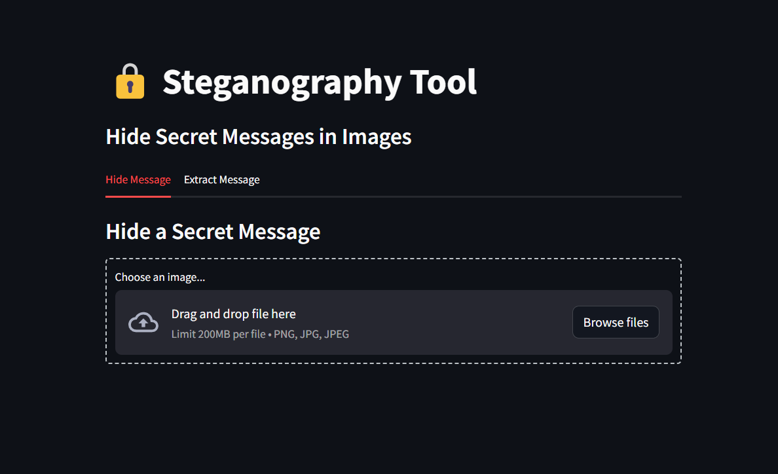
Results

Slide 8
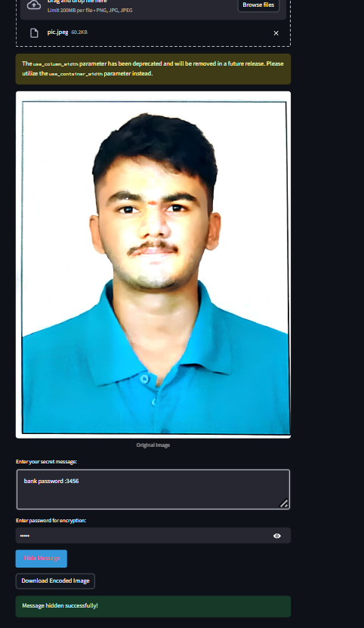

Slide 9
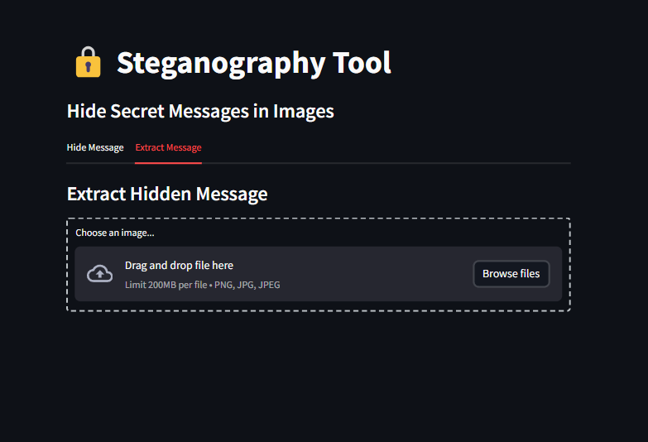

Slide 10
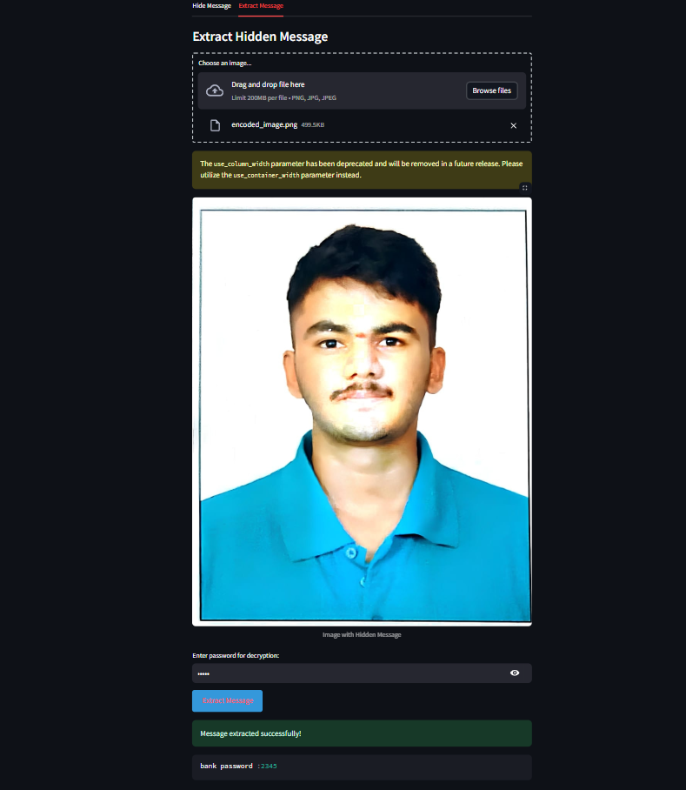

Slide 11
Conclusion
This project successfully implements a secure and user-friendly steganography solution for embedding textual data within digital images. By leveraging LSB steganography with password-based encryption and pseudo-random pixel selection, it ensures data integrity, image quality preservation, and enhanced security. The intuitive web interface built with Streamlit makes steganographic techniques accessible to both technical and non-technical users. With robust error handling, multi-format support, and real-time feedback, the solution balances usability and security effectively. This project has significant applications in secure communication, digital watermarking, and privacy protection, making it a valuable tool for individuals and organizations requiring covert data transmission.

Slide 12
GitHub Link
https://github.com/pranavkoushik/Stego_Shield.git

Slide 13
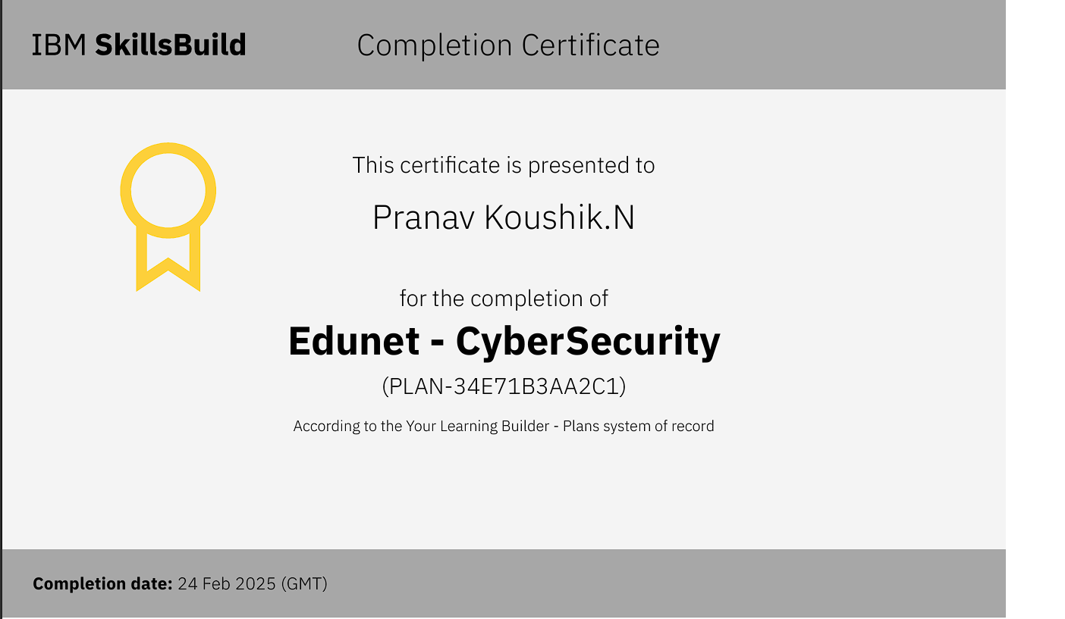
Ibm learning plan certificate

Slide 14
THANK YOU

